Slide 1

Testing at the Edges
TO BOLDY TEST WHERE
...YOU HAVE NEVER TESTED BEFORE
"USE THE FORCE, HARRY" - Gandalf
"USE THE FORCE H
Notes:
Welcome to Testing at the Edges.

Slide 2
NOT YET

Slide 3
Capture the Star* Market
STAR WARS
STAR TREK
BATTLESTAR GALACTICA
THE LAST STAR FIGHTER
STAR CONTROL
STAR CRAFT
STARBURSTS

Slide 4
New Starbursts Flavors!
STAR WARS: ROGUE ONE
The Rebels find themselves hungry
for a delicious snack and find
one in these all new Starbursts flavors:
Yoda Apple
Hoth Blueberry
Princess Leia Persimmon
R2D2 Orange
__________

Slide 5
Naming Things
Create a team of 2-4 people
Develop a new Starburst Flavor

Slide 6
Naming Things
Create a team of 2-4 people
Develop a new Starburst Flavor

Slide 7
Share The Flavor
What new flavor did your team develop?

Slide 8
Agenda
Introduction
Why should you test and what should you test?
Testing guards within resources
Testing and refactoring an existing helper method
Testing a custom resource
Testing an Ohai plugin

Slide 9
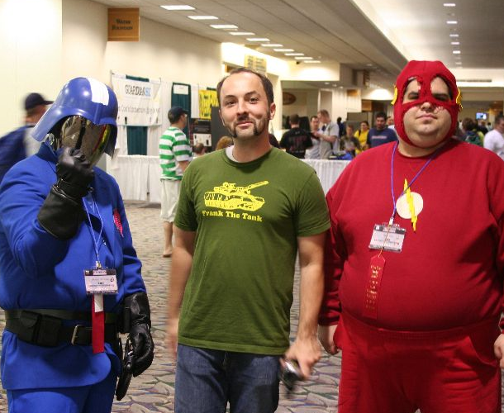
Franklin Webber
Training and Technical Content Lead
US Army - Radio/COMSEC Repairer (35E)
Tech Support
Quality Assurance
Software Developer Eng. in Test
Software Developer
Instructor / Trainer
Notes:
Before we start let me introduce myself.

Slide 10
You
Chef Cookbook Author
Understand Chef Resources and Cookbooks
Testing with ChefSpec, InSpec, Test Kitchen
Used a Custom Resource

Slide 11


Slide 12


Slide 13
Schedule
Work 50 minutes. Break for 10 minutes.
PACIFIC TIME
08:00 AM to 09:00 AM
09:10 AM to 10:00 AM
10:10 AM to 11:00 AM
11:10 AM to 12:00 PM
12:00 PM to 01:00 PM
01:10 PM to 02:00 PM
EASTERN TIME
11:00 AM to 12:00 PM
12:10 PM to 01:00 PM
01:10 PM to 02:00 PM
02:10 PM to 03:00 PM
03:10 PM to 04:00 PM
04:10 PM to 05:00 PM

Slide 14
What Are We Going to Do With That Time?
Concepts
Define the tools and techniques you are going to use to solve the problem
GROUP Exercise
We will explore a technique and solve the problem together
TEAM Exercise
Give yourself time to solve the problem
Pull Requests and Review
Submit your work and questions

Slide 15
Slides & Resources
goo.gl/f9fMWo

Slide 16
Agenda
Introduction
Why should you test and what should you test?
Testing and refactoring an existing helper method
Testing a custom resource
Testing an Ohai plugin

Slide 17
Testing Providing Value In Three Phases
1
2
3
Faster Development Cycle
Manages Risk
Capture regressions
Documents your software
Helps in your design
Ask the Right Questions

Slide 18
1
make change
run chef-client
bootstrap machine
provision machine
upload cookbook
ad hoc verification
Notes:
Carrying out testing at every stage (e.g. union, rehearsal) gives great feedback on its success at the cost of the time required for each cookbook to be pushed through this workflow.
Every change needs to be verified in this manner because Ruby, the language Chef is built on, is a dynamically typed programming language. Dynamically typed languages do checking at run-time as opposed to compile-time. This means that ruby files in our cookbook are not executed, thus not validated, until they are run. We also have the problem that we may even write the Ruby correctly but fail to understand the state of the host Operating System (OS) we are attempting to deploy against.

Slide 19
1
make change
run testing tools
automated verification
Notes:
Writing and executing tests decreases the amount of time spent between when you make a change to when you can verify that chance. This reduces the risk within the system.
How testing does address the speed of execution is by removing many of the outside dependencies and allowing you to execute your recipes against in-memory representations of the environment. Or automating the management of virtual machines and the process of executing your recipes against those virtual machines. And second, by allowing you to capture and automate the work that was previously performed in ad hoc verification.

Slide 20
Risk
1
Every change to our cookbooks introduce risk. Validating every change would take too long in this system. To alleviate that we often batch these changes up. Batching up the changes make it harder to discover when we introduced an error.
Notes:
Every time we make changes to our cookbooks we are introducing risk. Ideally we would validate every change to the cookbook but often do not because the amount of time it takes is far too prohibitive. Instead we often will batch up these changes into a set that we will validate. A set of changes like this can often hide errors that we may have introduced. This is definitely true as the complexity of the cookbook code increases.
We have a choice. We can slow down; validating every change. We can also stop making changes altogether. Or we can can adopt new practices, like testing, to help us validate these changes faster; allowing us to continue to move quickly as we continue to satisfy new requirements.

Slide 21

Capturing Regressions
2
Write a test that exposes the issue
Implement a solution
Watch the test pass
Also known as TDD

Slide 22
Executable Documentation
2
New and returning contributors are able to understand the state of the project, how it is configured, it's various states, current features, and issues.
The best documentation is the one that gets exercised!

Slide 23
Helps In Your Design
3
Writing from a test first approach places you in the shoes of the consumer before that of the creator. This could lead you to a more humane design.

Slide 24
Ask the Right Questions
3
When you start to consider the design from the consumer's perspective, it is hard not to step back further and ask yourself more questions about why you are doing what you are doing.
Pop goes the Why Stack!

Slide 25
Testing Providing Value In Three Phases
1
2
3
Faster Development Cycle
Manages Risk
Capture regressions
Documents your software
Helps in your design
Ask the Right Questions

Slide 26
Reviewing Code Samples
Before we start testing we should figure out what to test.
View First Code Sample
View Second Code Sample
View Third Code Sample
View Fourth Code Sample
1
Would you test this code?

Slide 27
Reviewing Code Samples
Before we start testing we should figure out what to test.
View First Code Sample
View Second Code Sample
View Third Code Sample
View Fourth Code Sample

Slide 28
Review with Your Team
Each person on the team share their answer.
If anyone disagrees yell out your team's Starburst flavor and then proceed to have a discussion of why you disagree.
If everyone agrees yell out your team's Starburst flavor and then proceed to talk about what would be difficult about testing that code.

Slide 29
Discussion
What questions we can we answer for you?

Slide 30
Agenda
Introduction
Why should you test and what should you test?
Testing and refactoring an existing helper method
Testing a custom resource
Testing an Ohai plugin

Slide 31
Agenda
Introduction
Why should you test and what should you test?
Testing and refactoring an existing helper method
Testing a custom resource
Testing an Ohai plugin

Slide 32
Agenda
Introduction
Why should you test and what should you test?
Testing and refactoring an existing helper method
Testing a custom resource
Testing an Ohai plugin

Slide 33
Agenda
Introduction
Why should you test and what should you test?
Testing and refactoring an existing helper method
Testing a custom resource
Testing an Ohai plugin

Slide 34
